Slide 1

Support Vector Machines
Prof. Dr. Faisal Shafait
Professor
School of Electrical Engineering and Computer Science (SEECS)
National University of Sciences and Technology (NUST), Islamabad

Slide 2
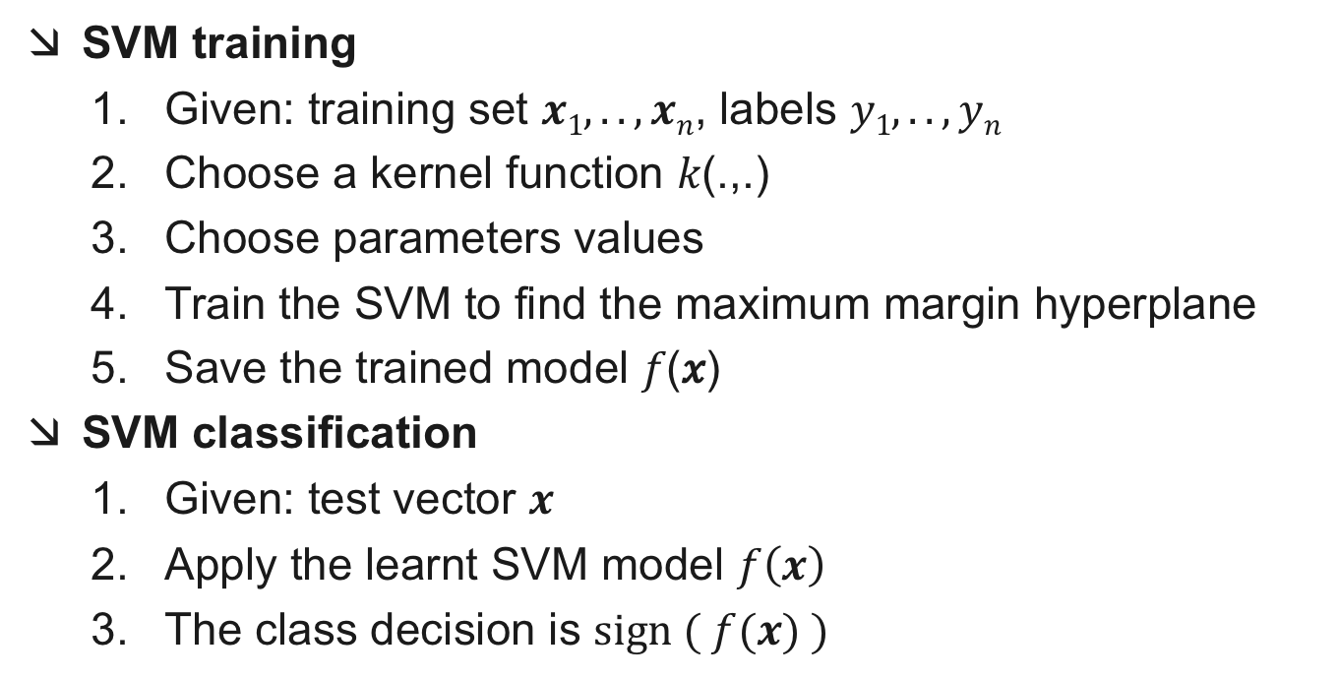
SVM Algorithm Summary
SVM training
Given: training set $x1,..,xn$, labels $y1, .., yn$
Choose a kernel function 𝑘(.,.)
Choose parameters values
Train the SVM to find the maximum margin hyperplane
Save the trained model 𝑓(𝑥)
SVM classification
Given: test vector $x$
Apply the learnt SVM model $f\left(x\right)$
The class decision is $\text{sign} ( f(x) )$

Slide 3
Input Data Normalization
Consider the following problem: Predict whether a house on sale will be sold within the next 30 days
Input features ?
Price
Area (sq. feet)
No. of bedrooms
Year of construction
Location
What to do if the year of construction in unknown?
How to represent location information?

Slide 4
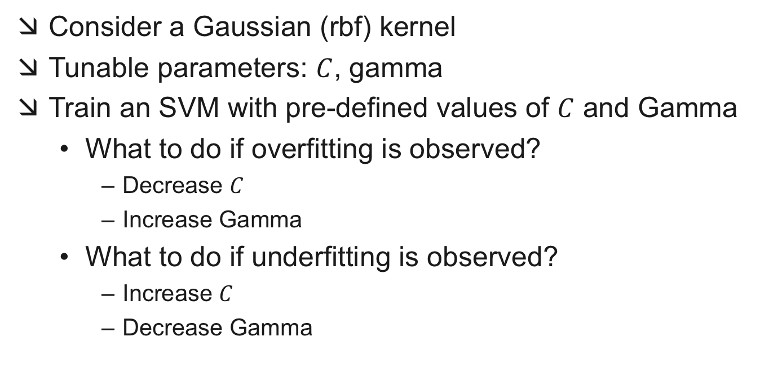
How to choose parameters?
Consider a Gaussian (rbf) kernel
Tunable parameters: $C$, gamma
Train an SVM with pre-defined values of $C$ and Gamma
What to do if overfitting is observed?
Decrease $C$
Increase Gamma
What to do if underfitting is observed?
Increase $C$
Decrease Gamma

Slide 5
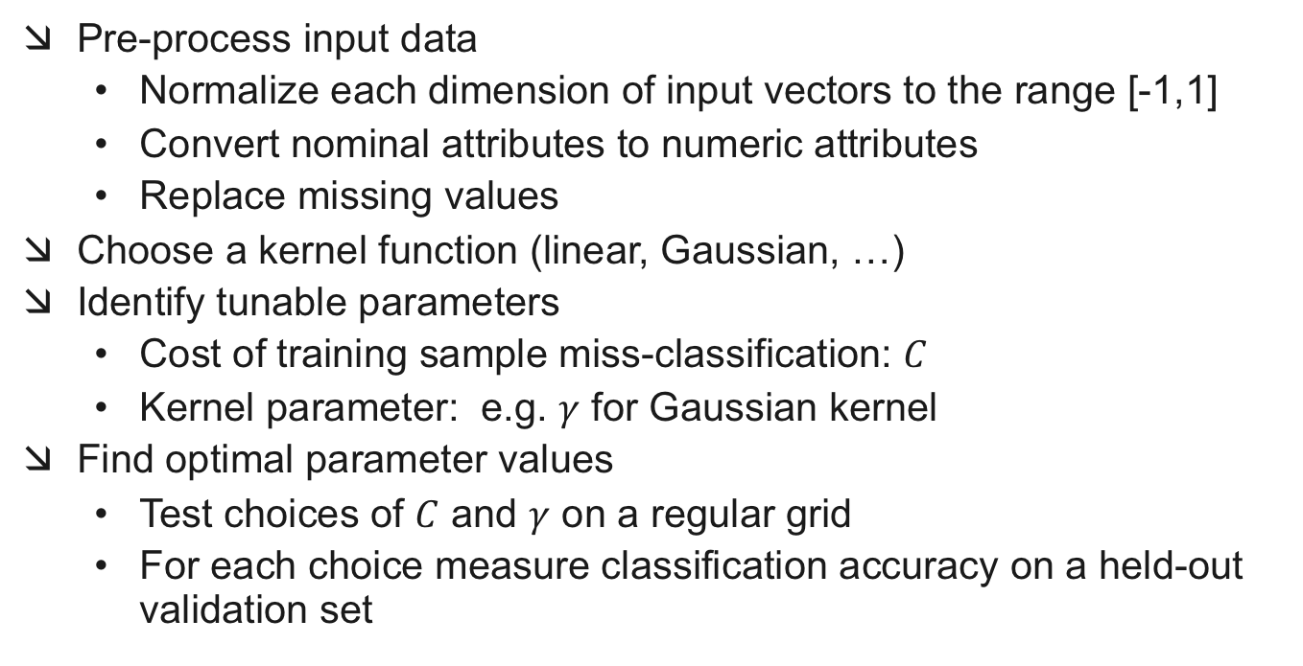
SVMs in Practice
Pre-process input data
Normalize each dimension of input vectors to the range [-1,1]
Convert nominal attributes to numeric attributes
Replace missing values
Choose a kernel function (linear, Gaussian, …)
Identify tunable parameters
Cost of training sample miss-classification: $C$
Kernel parameter: e.g. $γ$ for Gaussian kernel
Find optimal parameter values
Test choices of $C$ and $γ$ on a regular grid
For each choice measure classification accuracy on a held-out validation set

Slide 6

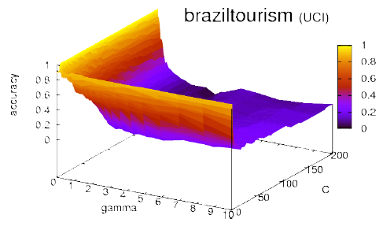
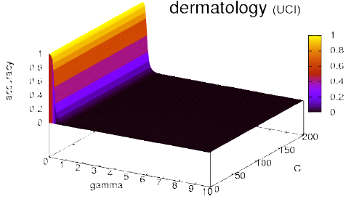
SVMs in Practice
Finding optimal parameters for EACH dataset is important

